Slide 1
RDD on NBA stats
Project for the exam of «Large Scale Computing», MSc. Computer Science, Genoa, a.y. 2020/21
Gian Paolo Bernardini
Muhammad Umair Yousuf
Mehrpuya Fathi Bonyadabad

Slide 2
Intro
The motivations is to work on a field (RDD) at the basis of the Map/Reduce pattern. Although RDD syntax is a low level one, it is the foundation for all the subsequent high level API like DataFrames and SparkSQL.
We asked ourselves some questions on behaviors of the teams in the decade 2010-2020, also respect to the teams that won a title. We have taken into consideration the regular season.
The starting point is at this link: https://www.nba.com/stats/teams/traditional/?sort=W_PCT&dir=-1

Slide 3
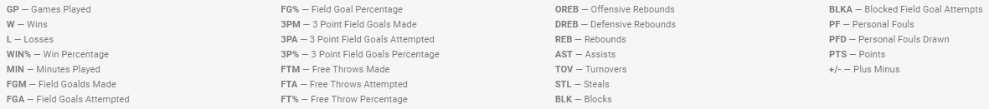
Glossary

Slide 4
Part 1
Gian Paolo Bernardini

Slide 5
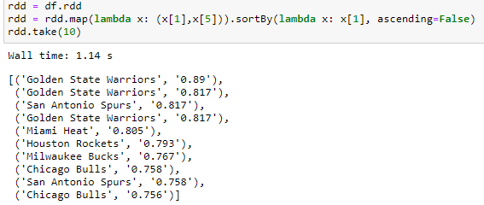
Q1 which is the most winning team in all the decade, based on WIN% (W/GP)?
Gathering the data
At first al the data have been gathered.
The main data frame has been persisted in memory in order not to load it anymore and redo calculations.

Slide 6
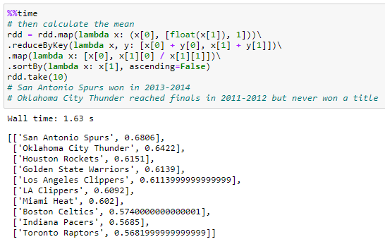
Q1 which is the most winning team in all the decade, based on WIN% (W/GP)?
Calculate the mean
The mean has been calculated based on a map reduce approach.
As it may be noticed only one on the first three teams that have the best % of winning, won a title, so having a great regular season, don’t assure the winning of a title.

Slide 7
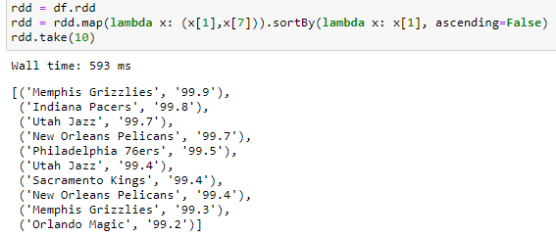
Q2 is scoring a lot of points important for the winning of a title?
Gathering the data
Again here have been gathered all the teams that in average have scored most points.

Slide 8
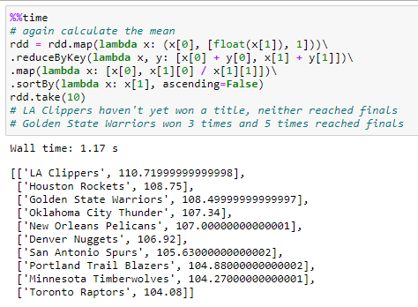
Q2 is scoring a lot of points important for the winning of a title?
Calculate the mean
The mean has been calculated based on a map reduce approach.
The team that in the decade has scored most points in average was LA Clippers which never won a title, but Golden State Warriors won 3 times and 5 times reached finals, so scoring a lot of points, could be a good indicator of a potential title winner.

Slide 9
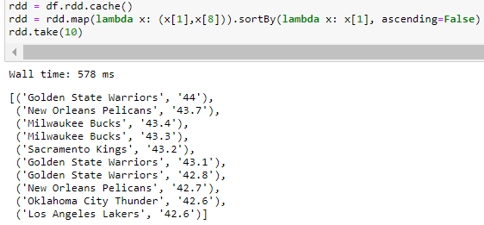
Q3 how the FGM (Field Goals Made) percentage influences the winning of a title? (Compared to the mean of those who have won a title)
The same policy is applied
The best FG makers of all the decade have been gathered.
.cache() permits to cache in memory the RDD in use and to load it quickly.

Slide 10
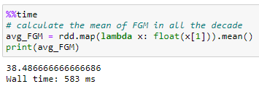
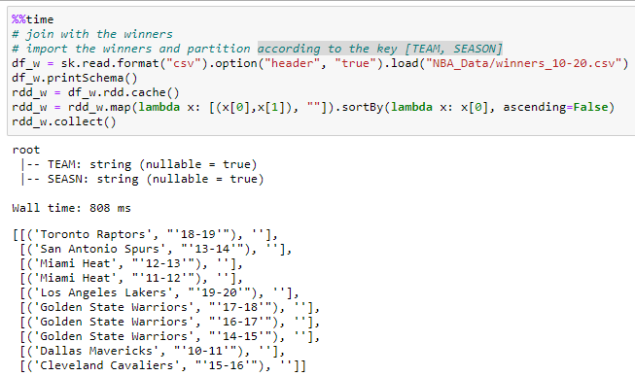
Q3 how the FGM (Field Goals Made) percentage influences the winning of a title?
Calculate the mean
The mean has been calculated based on the command .mean().
Join with the winners
Winners have been imported according to the key [TEAM, SEASON].

Slide 11
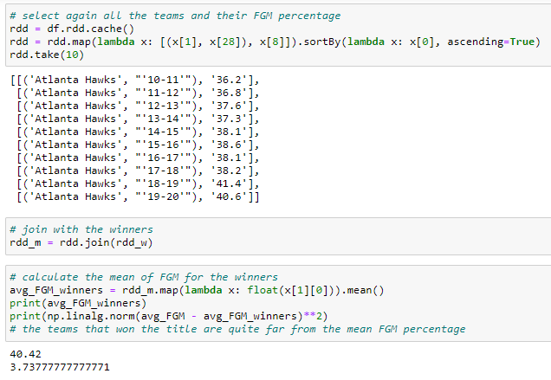
Q3 how the FGM (Field Goals Made) percentage influences the winning of a title?
Comparison with the regular season
the teams that won the title are quite far from the mean FGM percentage in all the decade.

Slide 12
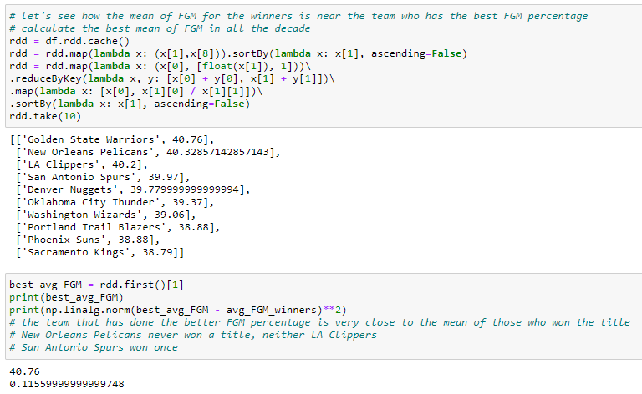
Q4 how the mean of FGM for the winners is near to the mean of the team who has the best FGM percentage?
Golden State Warriors has done the better FGM percentage, very close to the mean of those who won the title.

Slide 13
Part 2
Mehrpuya Fathi Bonyadabad

Slide 14
Part 3
Muhammad Umair Yousuf

